Slide 1
2 ELECTROCHEMISTRY
Types of electrodes, Electrode potential, Electrical double layer, Calomel electrode
Measurement of electrode potential
Dr.Rani Pavithran
Assistant Professor & Head
Department of Chemistry
College of Engineering Trivandrum

Slide 2
Types of electrodes
What are the different types of electrodes?
1) Metal-Metal ion electrodes: These are the electrodes where a metal is dipped in its metal salt solution.
Eg: Cu|CuSO₄, Zn|ZnSO₄
2) Gas electrodes: These are the electrodes where a gas is in contact with an inert metal dipped in an ionic solution of gas molecules.
Eg: Hydrogen electrode Pt/H₂/H⁺
3) Metal /insoluble salt electrodes: These are the electrodes where a metal will be in contact with its insoluble salt.
Eg: Calomel electrode (Hg|Hg₂Cl₂/Cl⁻), Silver –silver chloride electrode (Ag|AgCl/KCl)

Slide 3
Types of electrodes
4) Ion selective electrodes: These are the electrodes which are sensitive to particular ionic species and will develop a potential when a membrane is in contact with an ionic solution.
Eg: Glass electrode
5) Redox Electrode: Electrode is in contact with a redox system. Eg. Pt electrode in contact with a mixture of ferrous chloride FeCl₂ and ferric chloride FeCl_{3.} Pt/Fe²⁺/Fe³⁺
6) Reference electrodes
Electrodes which are used to determine single electrode potential of other electrodes. They are also called as standard reference electrodes. There are two types of reference electrodes.

Slide 4
Reference electrodes
1. Primary reference electrode: Eg: Standard Hydrogen Electrode.
2. Secondary reference electrode: Eg: Calomel electrode, Silver electrode, ion selective electrode.

Slide 5
Calomel electrode
Explain the construction and working of Calomel electrode
Calomel electrode consists of a glass tube with two side tubes. Mercury is placed at the bottom, above which a layer of mercury and mercurous chloride (called calomel) and remaining portion of the tube is filled with saturated KCl solution through one of the side tube. The other side tube is connected to a salt bridge. A platinum wire is dipped into the mercury for external electrical contact. Electrode potential of the cell depends on the concentration of KCl used.

Slide 6
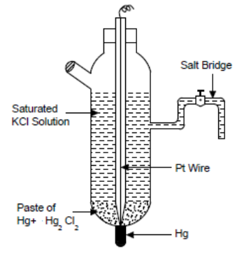
Calomel electrode
KCl concentration | 0.1N | 1N | Saturated
Electrode potential (V) | 0.3335 | 0.2810 | 0.2422

Slide 7
Calomel electrode
The calomel electrode acts as both anode and cathode depending upon the other electrode used.
When it acts as anode the electrode reactions is,
2Hg + 2Cl⁻ Hg₂Cl₂ + 2e-
When it acts as cathode the electrode reaction is
Hg₂Cl₂ + 2e- 2Hg + 2Cl⁻
Overall reaction: Hg₂Cl₂ + 2e⁻ 2Hg + 2Cl⁻
Representation : Hg| Hg₂Cl₂ |KCl (satd.)
The electrode potential (reduction potential) is given by
E _{cal} = E⁰ – 0.0591 log [Cl⁻]
The electrode potential is decided by the concentration of chloride ions and the electrode is reversible with respect to chloride ions.

Slide 8
Advantages
1) Calomel electrode is simple to construct.
2) Cell potential is reproducible
3) Potential is stable over a long period.
3) Cell potential does not vary with temperature. Hence it is used as secondary reference electrode.
Applications:
1. It is used as secondary reference electrode in measurement of single electrode potential of other electrodes instead of SHE.
2. It is used as reference electrode in potentiometric titrations.
3. It is used as reference electrode with glass electrode in pH determination.

Slide 9
Emf of a cell
The potential difference between two electrodes of the cells which causes the flow of current is called electromotive force. It is denoted by E_{cell}.
Emf of cell = Reduction potential of cathode - Reduction potential of anode
E_{cell} = E_{cathode} - E_{anode}
Single electrode potential: Electrode potential is the electrical potential developed at the interface between metal and its solution when it is in contact with a solution of its own ions and the two solutions are in equilibrium with each other. It is denoted by E.
Standard electrode potential: Standard electrode potential is the potential developed when the pure metal electrode is in contact with a solution of its ions of unit concentration at 298K. It is denoted by E⁰.

Slide 10
origin of single electrode potential
When a metal electrode is in contact with a solution of its own ions, one of the following two chemical reactions take place.
i. Metal passes into the solution as metal ions leaving behind the electrons on the metal as follows
M M^{n+} + ne- (Dissolution)
Thus, the metal acquires the –ve charge.
ii. Positive metal ions from the solution deposits on the metal electrode as metal atoms as follows
M ^{n+} + ne- M (Deposition)
Thus, the metal acquires the +ve charge.

Slide 11
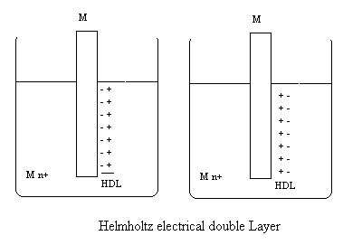
Helmholtz Electrical double layer
If the dissolution reaction is faster than the deposition reaction, the liberated e-s accumulate on the surface of metal making it –vely charged. This –vely charged electrode surface attracts a layer of +vely charged ions at the interface. Thus a double layer called Helmholtz electrical double layer is formed at the metal solution interface.

Slide 12
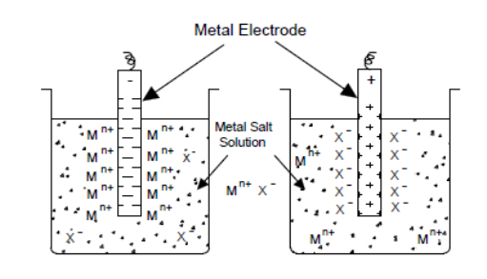
Helmholtz Electrical double layer
Similarly, if the deposition reaction is faster than the dissolution reaction, a layer of +ve charges formed on the surface attracts a layer of –ve charges, develops an electrical double layer.
Across this double layer, develops a potential called single electrode potential.

Slide 13
Measurement of electrode potential using calomel electrode
It is impossible to know the absolute value of a single electrode potential because neither oxidation nor reduction takes place independently.
Thus we need the relative electrode potential by coupling it with a reference electrode.
The primary reference electrode is the normal or standard hydrogen electrode (NHE or SHE), but it is very difficult to setup.
So we often go for secondary reference electrode like saturated calomel electrode.
Measurement of electrode potential of Zn-electrode:
In order to measure the standard electrode potential of Zn electrode, (Zn- electrode dipped in 1M ZnSO₄ solution), the Zn electrode is coupled with saturated calomel electrode through a salt bridge and the emf of the cell is measured.

Slide 14
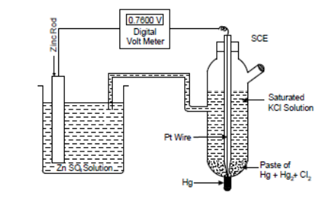
Measurement of electrode potential using calomel electrode
EMF is defined as the voltage of the cell when no current is drawn from the cell.
Hence emf of the cell must be measured without drawing any current from the cell. Analog volt meter can not be used since it draws current from the cell.
Digital volt meter is used for measuring emf.
In digital volt meter, the measurement of potential is based on field effect transistors, which draws only negligible current from the cell during the measurement of emf. Wheatstone bridge principle was used earlier to measure emf of cells before the advancement of digital voltmeters.

Slide 15


Measurement of electrode potential using calomel electrode
The electrode having higher reduction potential undergoes reduction and is the cathode and the electrode having lower reduction potential undergoes oxidation and is the anode.
The reduction potential of saturated calomel electrode (E_{SCE} = 0.2422) is higher than standard reduction potential of Zn²⁺/Zn = -0.76V .
Therefore reduction reaction takes place at SCE and the Zn electrode undergoes oxidation.
At cathode:
At anode:
The cell may represented as Zn/Zn²⁺ // Cl⁻/Hg₂Cl₂/Hg
E_{cell} = E_{R} - E_{L}
E_{cell} = E_{SCE} - E_{Zn2+/Zn}
when concentration of [Zn²⁺] = 1M and temperature = 25°C,
E_{cell} = 0.2422 - E⁰_{Zn}²⁺_{/Zn}
By measuring cell emf E⁰_{Zn2+/Zn} can be calculated.

Slide 16
Measurement of electrode potential of copper electrode using calomel electrode
In order to measure the standard electrode potential of Cu electrode, (Cu- electrode dipped in 1MCuSO₄ solution), the Cu electrode is coupled with saturated calomel electrode through a salt bridge and the cell emf is measured.
The electrode having higher reduction potential undergoes reduction and is the cathode
and the electrode having lower reduction potential undergoes oxidation and is the anode.
The reduction potential of saturated calomel electrode (E_{SCE} = 0.2422) is lower than standard reduction potential of Cu²⁺/Cu = +0.34V. Therefore oxidation reaction takes place at SCE and the Cu electrode undergo reduction

Slide 17



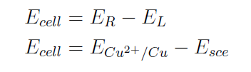
Measurement of electrode potential of copper electrode using calomel electrode
At anode
At cathode
The cell is represented as
when concentration of [Cu²⁺] = 1M and temperature = 25°C
E_{cell} = E⁰_{Cu2+/Cu}- 0.2422
By measuring cell emf E⁰_{Cu2+/Cu} can be calculated.

